Slide 2
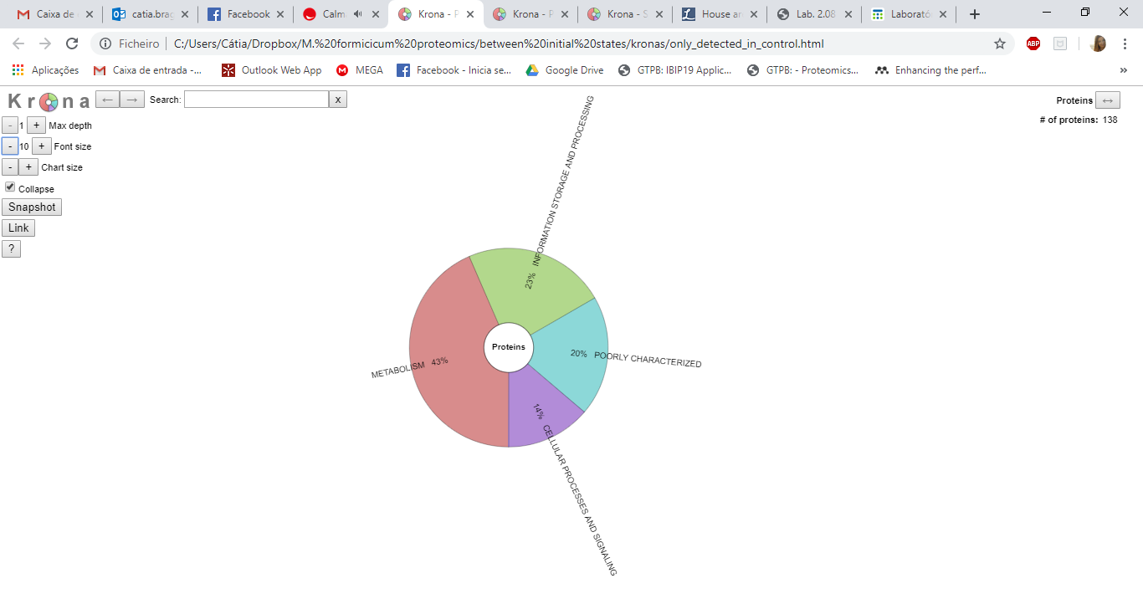
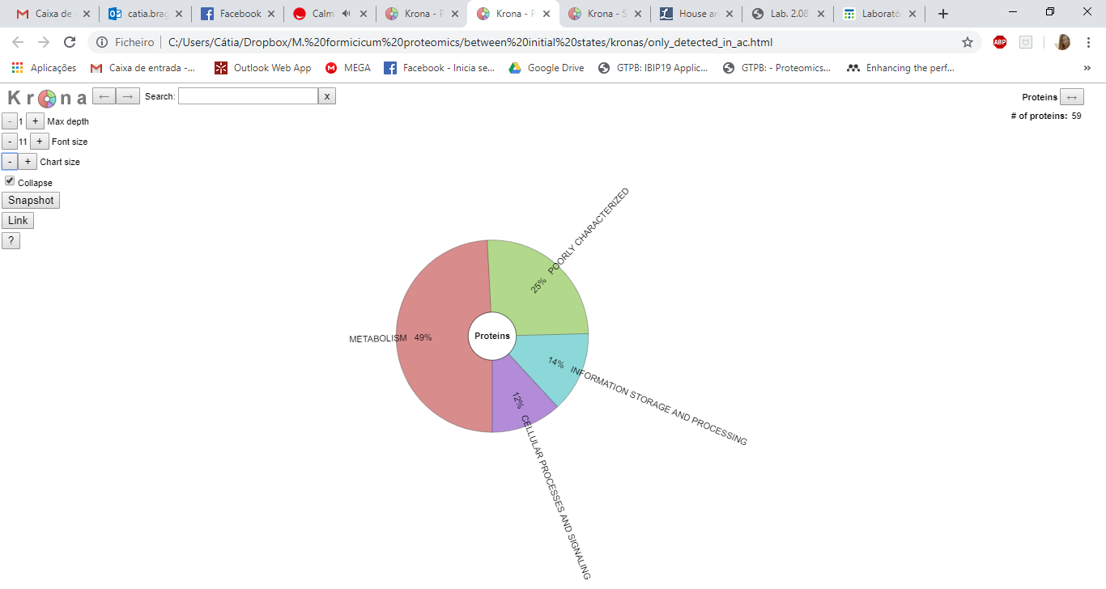
a) Methanobacterium formicicum pure culture
b) Methanobacterium formicicum pure culture in the presence of 0.5 g/L AC
23 % INFORMATION STORAGE AND PROCESSING
25 % POORLY CHARACTERIZED
20 % POORLY CHARACTERIZED
14 % INFORMATION STORAGE AND PROCESSING
49 % METABOLISM
43 % METABOLISM
14 % CELLULAR PROCESSES AND SIGNALING
12 % CELLULAR PROCESSES AND SIGNALING

Slide 3
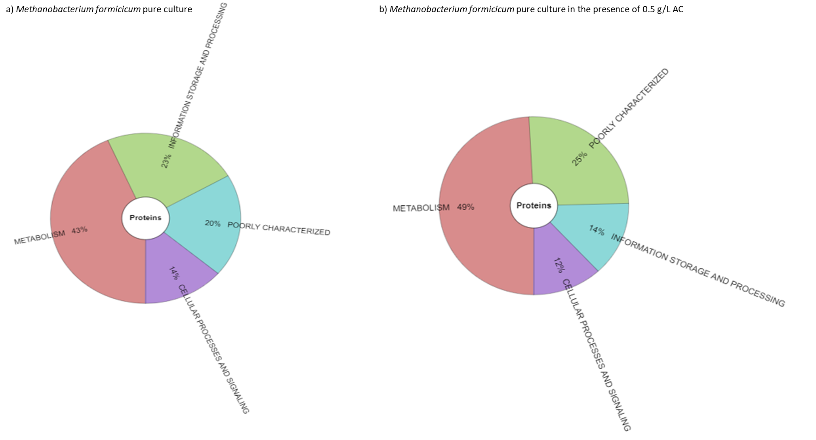

Slide 4
